Slide 1
Titanic Survivor Prediction
By Hemaksh Chaturvedi(hac9624) Rhuthvik Dedukuri(rd3377)

Slide 2
We intend to answer who is most likely to survive using Machine Learning Algorithms

Slide 3
Understanding the Data
Loaded necessary libraries
Loaded the dataset
Performing EDA
Found Correlation between the attributes of the dataset
Dropped the unnecessary attributes
Checked for NA values in attributes
Removed Attribute ‘cabin’ since an alphanumeric attribute won't help us classify
Fill the empty values of "Embarked" column with the least attribute frequency. here, we fill the NA "Embarked" with Q.

Slide 4
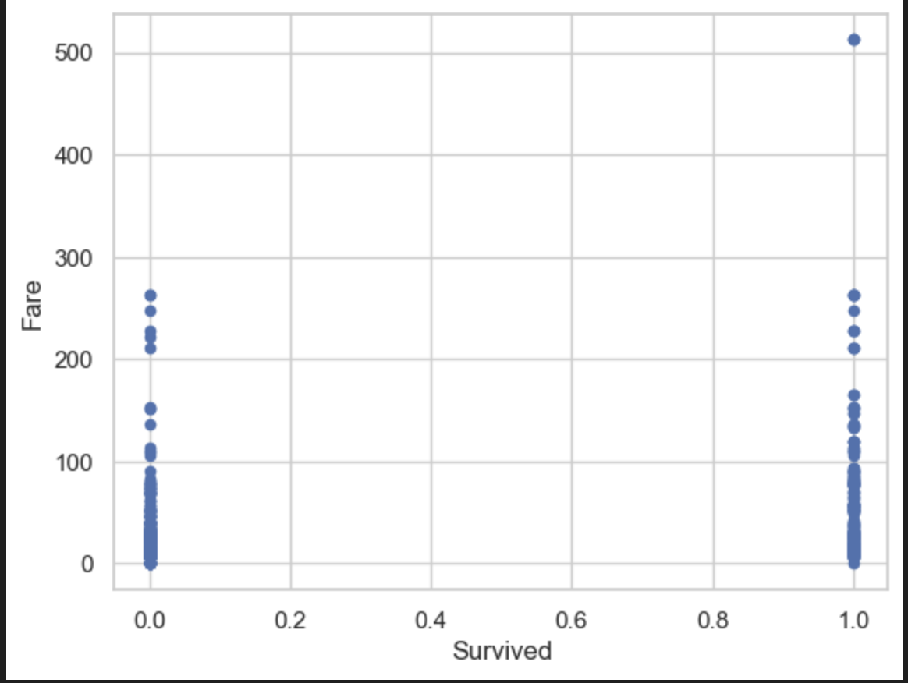
Understanding the Data
4. Checked for relation between ‘fare’ and ‘survival
There was an equal opportunity of survival regardless of the fare. There was only one outlier.

Slide 5
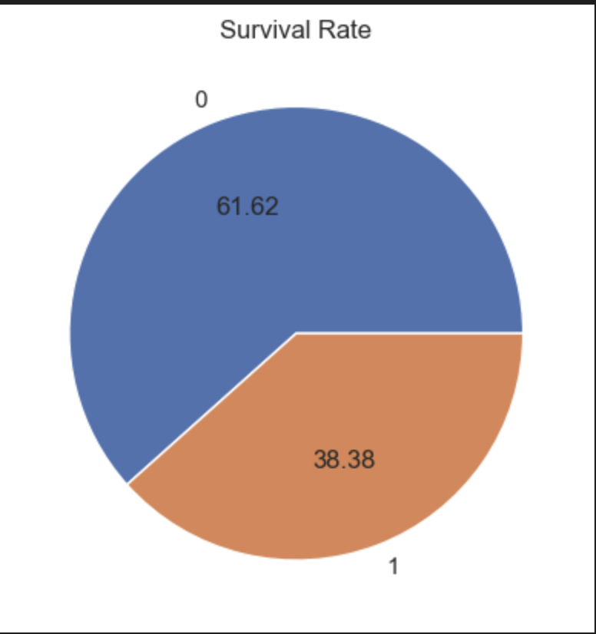
Understanding the Data
5. Visualized the rate of survival
0 - did not survive
1 - survived

Slide 6
Understanding the Data
6. Visualized counts of {Pclass', 'Sex', 'Embarked'} by Category from Train Set
7. Visualized distribution of {'Age', 'SibSp', 'Parch', 'Fare'} from Train Set
8. Visualized counts of {Pclass', 'Sex', 'Embarked'} by Category from Test Set
9. Visualized distribution of {'Age', 'SibSp', 'Parch', 'Fare'} from Test Set
10. Set dummies for {'Sex', 'Pclass', 'Embarked'} in train and test set
11. Created a swarm plot which showcases the ‘age’, ‘sex’ and ‘gender’
12. Performed MinMaxScaler on ‘age’ and ‘fare’ to transform the data

Slide 7
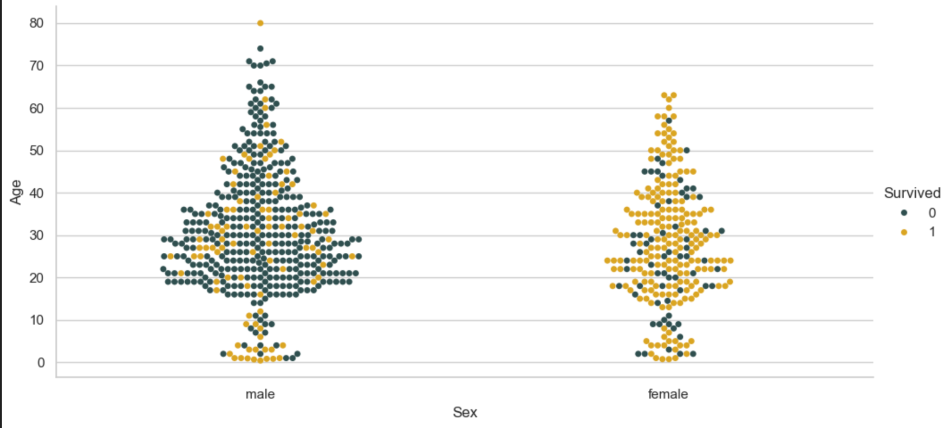
Understanding the Data

Slide 8
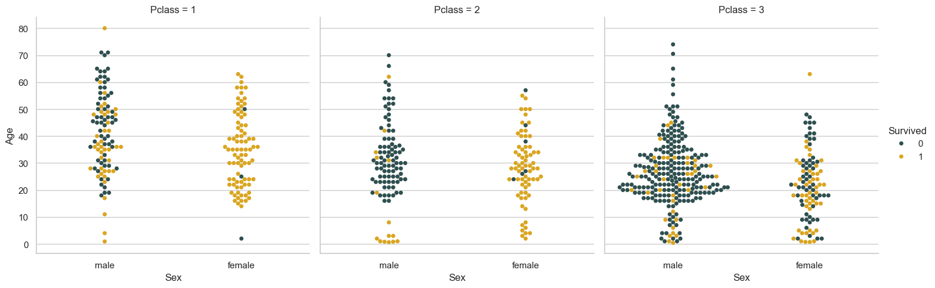
Understanding the Data

Slide 9
Algorithms Used
Logistic Regression
Random Forest

Slide 10
Logistic Regression
Logistic regression on the Titanic dataset predicts passenger survival (1) or non-survival (0) based on features like class, age, gender, and fare. It offers a probabilistic view of predictions, aiding in understanding key factors influencing survival outcomes.

Slide 11
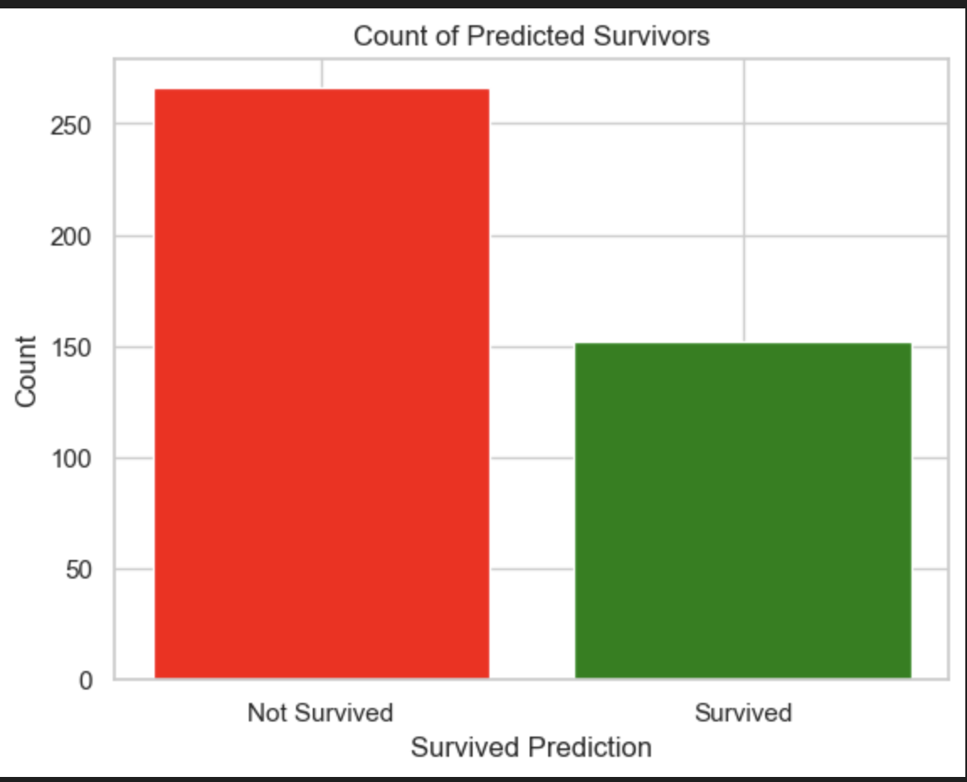
Logistic Regression
We predicted that 266 people did not survive and 152 people survived

Slide 12
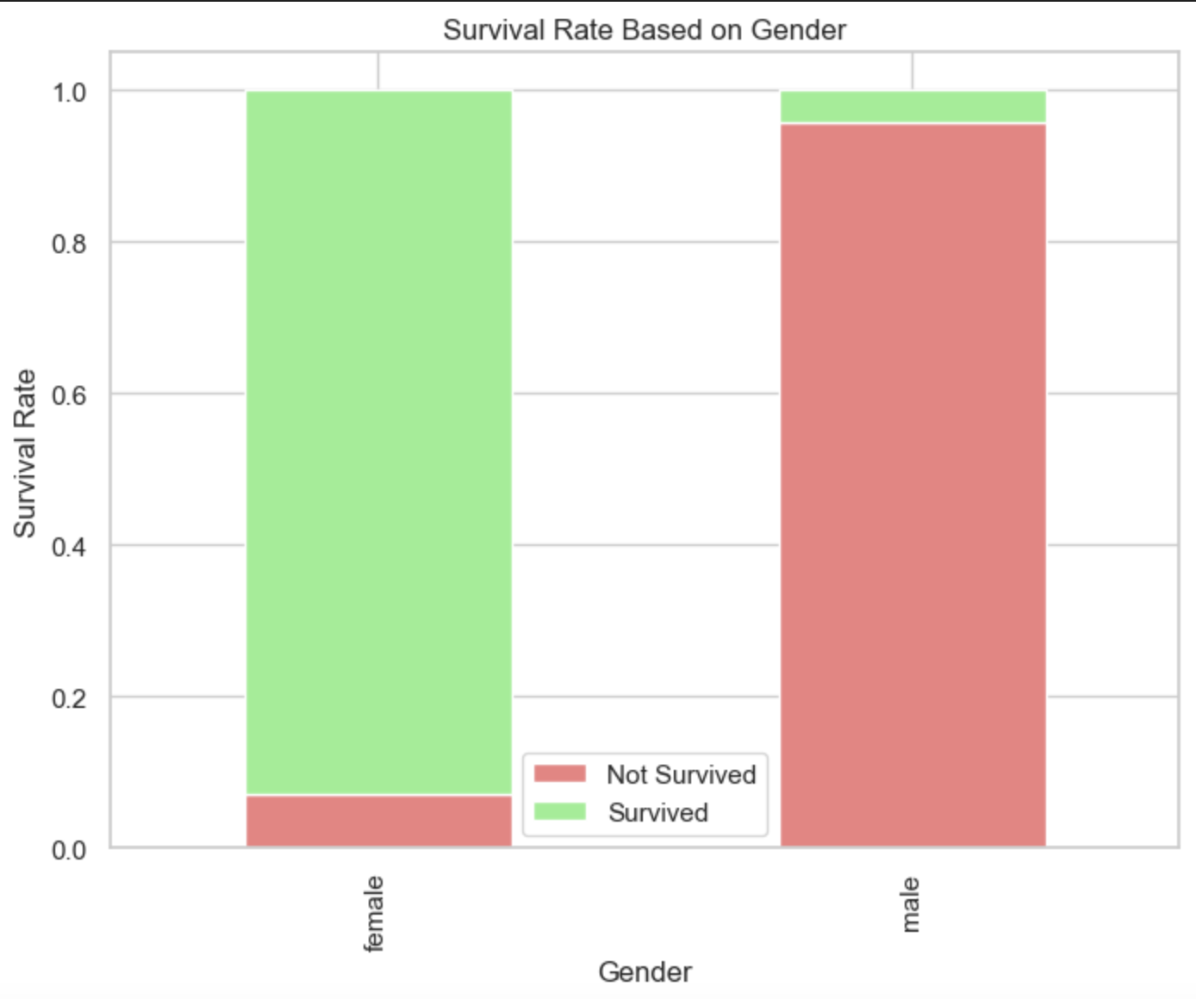
Logistic Regression
We predicted the survival rate based on gender and we can infer that most females on the ship survived compared while on the other hand most males on the ship did not survive.

Slide 13
Random Forest
Random Forest on the Titanic dataset leverages an ensemble of decision trees to predict survival, excelling in capturing complex relationships among features like age, class, and gender. Its robustness against overfitting and ability to handle non-linear patterns make it effective for modeling and predicting survival outcomes.

Slide 14
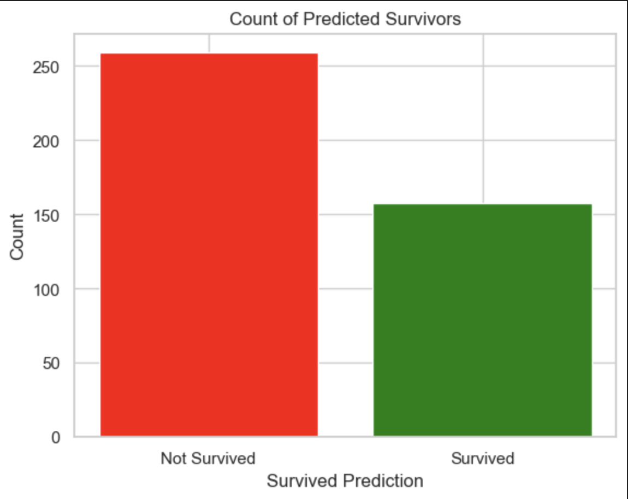
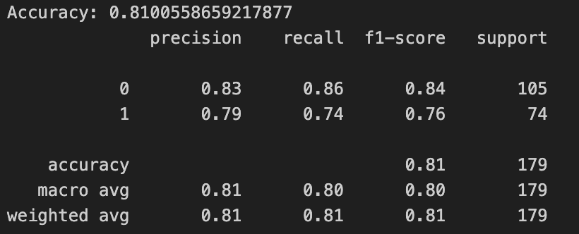
Random Forest
We predicted that 259 people did not survive and 158 people survived

